Slide 1
Data Analytics – Lesson 06 Describing Data using R
Jeffrey Strickland, Ph.D., CMSP, ASEP
CEO Humalytica Analytics

Slide 2
Example– Results from an Experiment on Plant Growth
PlantGrowth is a R dataset containing the results from an experiment to compare yields (as measured by dried weight of plants) obtained under a control and two different treatment conditions.
Format: A data frame of 30 cases on 2 variables.
[, 1] weight numeric
[, 2] group factor
The levels of group are ‘ctrl’, ‘trt1’, and ‘trt2’.
Source - Dobson, A. J. (1983) An Introduction to Statistical Modelling. London: Chapman and Hall.

Slide 3
Adjust the Data Frame
The first step in the investigation is to take a copy of the data frame so that we can make some adjustments as necessary while leaving the original data alone.
We use the factor function to re-define the labels of the group variables that will appear in the output and graphs:
plant.df = PlantGrowth
plant.df$group = factor(plant.df$group,
labels = c("Control", "Treatment 1", "Treatment 2"))
The labels argument is a list of names corresponding to the levels of the group factor variable.

Slide 4
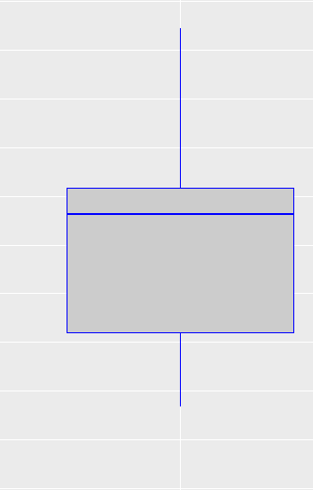
Boxplot Analysis
We will construct a boxplot of the distributions of the dried weights for the three competing groups is created using the ggplot package:
> require(ggplot2)
Highest Value
25%
Upper Quartile
25%
Interquartile Range
25%
Median
Lower Quartile
25%
Lowest Value

Slide 5
Boxplot Analysis
ggplot(plant.df, aes(x = group, y = weight)) +
geom_boxplot(fill = "grey80", colour = "blue") +
scale_x_discrete() + xlab("Treatment Group") +
ylab("Dried weight of plants")
The geom_boxplot() option is used to specify background and outline colours for the boxes.
The axis labels are created with the xlab() and ylab() options.
The plot that is produce show on the following chart:

Slide 6
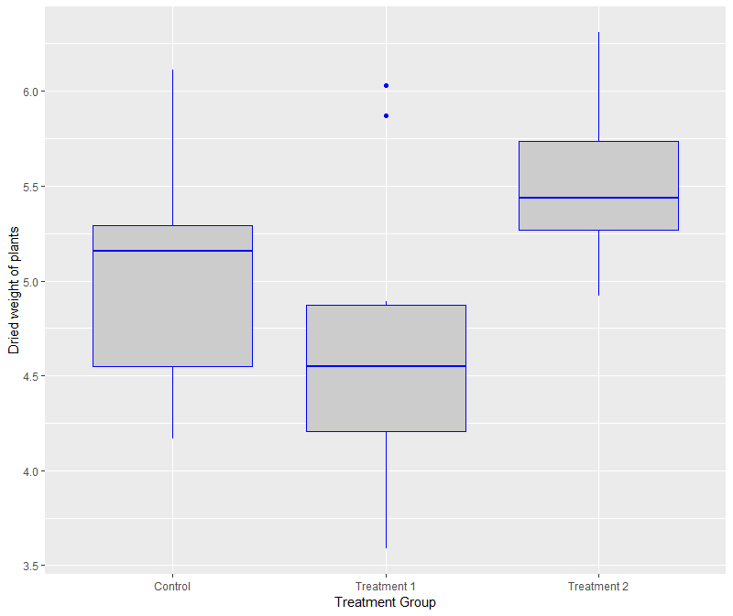
Boxplot Analysis
Initial inspection of the data suggests that there are differences in the dried weight for the two treatments but it is not so clear cut to determine whether the treatments are different to the control group.
Trt 1 and Trt 2 dried weights are different (no overlap)

Slide 7
Use lm to investigate ANOVA model
To investigate these differences we fit the one-way ANOVA model using the lm (linear model) function and look at the parameter estimates and standard errors for the treatment effects.
The function call is:
> plant.mod1 = lm(weight ~ group,
data = plant.df)
We save the model fitted to the data in an object so that we can undertake various actions to study the goodness of the fit to the data and other model assumptions.
The standard summary of a lm object is used to produce the following output:
> summary(plant.mod1)
Call:
lm(formula = weight ~ group, data = plant.df)
Residuals:
Min 1Q Median 3Q Max
-1.0710 -0.4180 -0.0060 0.2627 1.3690
Coefficients:
Estimate Std. Error t value Pr(>|t|)
(Intercept) 5.0320 0.1971 25.527 <2e-16 ***
groupTreatment 1 -0.3710 0.2788 -1.331 0.1944
groupTreatment 2 0.4940 0.2788 1.772 0.0877 .
---
Signif. codes: 0 ‘***’ 0.001 ‘**’ 0.01 ‘*’ 0.05 ‘.’ 0.1
‘ ’ 1

Slide 8
Model analysis results
The model output indicates some evidence of a difference in the average growth for the 2nd treatment compared to the control group.
An analysis of variance table for this model can be produced via the anova command:
> anova(plant.mod1)
Analysis of Variance Table
Response: weight
Df Sum Sq Mean Sq F value Pr(>F)
group 2 3.7663 1.8832 4.8461 0.01591 *
Residuals 27 10.4921 0.3886
---
Signif. codes: 0 ‘***’ 0.001 ‘**’ 0.01 ‘*’ 0.05
‘.’ 0.1 ‘ ’ 1
This table confirms that there are differences between the groups which were highlighted in the model summary.

Slide 9
95% Confidence Interval
The function confint is used to calculate confidence intervals on the treatment parameters, by default 95% confidence intervals:
> confint(plant.mod1)
2.5 % 97.5 %
(Intercept) 4.62752600 5.4364740
groupTreatment 1 -0.94301261 0.2010126
groupTreatment 2 -0.07801261 1.0660126

Slide 10
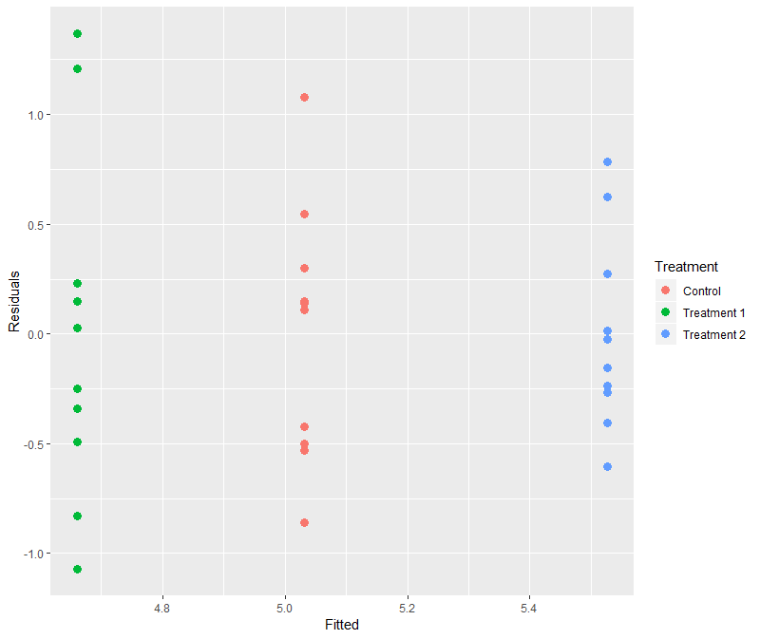
Residual Analysis
We can see that there is no major problem with the diagnostic plot but some evidence of different variabilities in the spread of the residuals for the three treatment groups
The model residuals can be plotted against the fitted values to investigate the model assumptions.
First we create a data frame with the fitted values, residuals and treatment identifiers:
plant.mod = data.frame(Fitted =
fitted(plant.mod1),
Residuals = resid(plant.mod1),
Treatment = plant.df$group)
and then produce the plot:
ggplot(plant.mod, aes(Fitted, Residuals,
colour = Treatment)) + geom_point()

Slide 11
ANOVA on the Data Directly
The R function aov builds an ANOVA model from the data rather than from a model.
> plant.aov<-aov(weight ~ group,plant.df)
The basic result doen not give a great deal of information.
We need to view the summary so try:
> summary(plant.aov)
Df Sum Sq Mean Sq F value Pr(>F)
group 2 3.766 1.8832 4.846 0.0159 *
Residuals 27 10.492 0.3886
---
Signif. codes: 0 ‘***’ 0.001 ‘**’ 0.01 ‘*’ 0.05 ‘.’
0.1 ‘ ’ 1

Slide 12
Tukey HSD Test
So far we have conducted a simple one-way anova. In this instance we see that there is a significant effect of diet upon growth.
However, there are 6 treatments.
We would like to know which of these treatments are significantly different from the controls and from other treatments.
We need a post-hoc test. R provides a simple function to carry out the Tukey HSD test.
This will show all the paired comparisons like so:
> TukeyHSD(plant.aov)
Tukey multiple comparisons of means
95% family-wise confidence level
Fit: aov(formula = weight ~ group, data = plant.df)
$`group`
diff lwr upr p adj
Treat 1-Control -0.371 -1.0622161 0.3202161 0.3908711
Treat 2-Control 0.494 -0.1972161 1.1852161 0.1979960
Treat 2-Treat 1 0.865 0.1737839 1.5562161 0.0120064
The table/output shows us the difference between pairs, the 95% confidence interval(s) and the p-value of the pairwise comparisons.

Slide 13

Introduction
Analysis of variance (ANOVA) is a collection of statistical models used to analyze the differences between group means and their associated procedures (such as “variation” among and between groups)
Developed by R.A. Fisher.
The observed variance in a particular variable is partitioned into components attributable to different sources of variation.
In its simplest form, ANOVA provides a statistical test of whether or not the means of several groups are equal, and therefore generalizes the $t$-test to more than two groups.
As doing multiple two-sample $t$-tests would result in an increased chance of committing a statistical type I error, ANOVAs are useful in comparing (testing) three or more means (groups or variables) for statistical significance.

Slide 14
Dog Show Example
The analysis of variance can be used as an exploratory tool to explain observations.
Dog Show
A dog show is not a random sampling of the breed: it is typically limited to dogs that are male, adult, pure-bred and exemplary.
A histogram of dog weights from a show might plausibly be rather complex, like the yellow-orange distribution shown in the illustrations.
Suppose we wanted to predict the weight of a dog based on a certain set of characteristics of each dog.
Before we could do that, we would need to explain the distribution of weights by dividing the dog population into groups based on those characteristics.
A successful grouping will split dogs such that
a) each group has a low variance of dog weights (meaning the group is relatively homogeneous) and
b) the mean of each group is distinct (if two groups have the same mean, then it isn’t reasonable to conclude that the groups are, in fact, separate in any meaningful way).

Slide 15
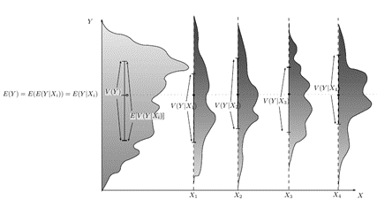
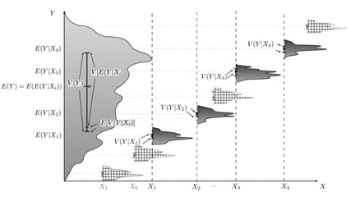
A Graphical Example

Slide 16

Uses
Classical ANOVA for balanced data does three things at once:
As exploratory data analysis, an ANOVA is an organization of an additive data decomposition, and its sums of squares indicate the variance of each component of the decomposition (or, equivalently, each set of terms of a linear model).
Comparisons of mean squares, along with $F$-tests ... allow testing of a nested sequence of models.
Closely related to the ANOVA is a linear model fit with coefficient estimates and standard errors (Gelman, 2005)
Additionally:
It is computationally elegant and relatively robust against violations of its assumptions.
ANOVA provides industrial strength (multiple sample comparison) statistical analysis.
It has been adapted to the analysis of a variety of experimental designs.

Slide 17
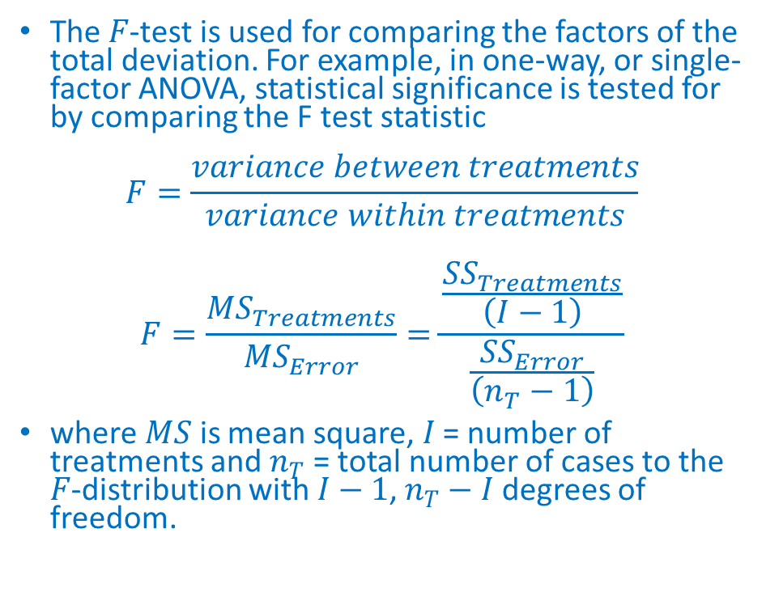
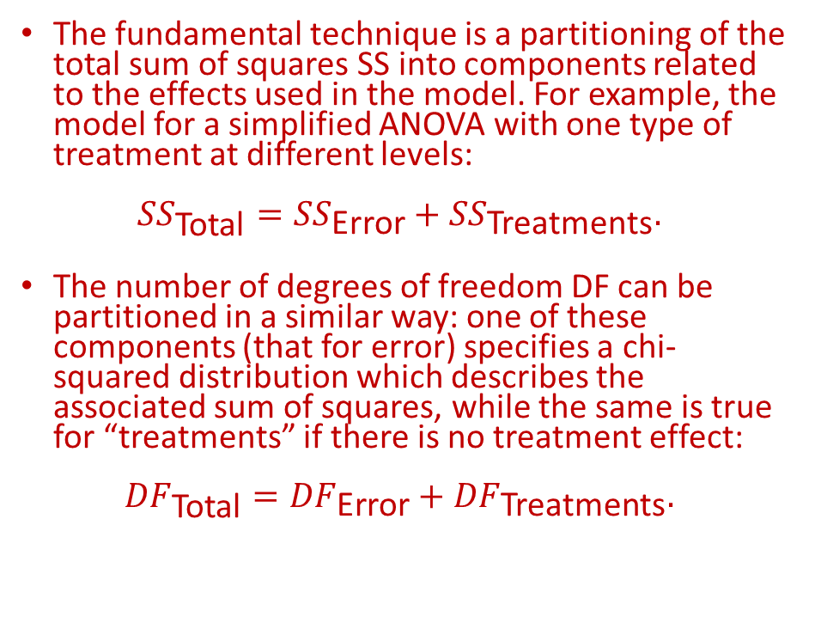
Particulars
The fundamental technique is a partitioning of the total sum of squares SS into components related to the effects used in the model. For example, the model for a simplified ANOVA with one type of treatment at different levels:
$${SS}_{\text{Total}}={SS}_{\text{Error}}+{SS}_{\text{Treatments}}.$$
The number of degrees of freedom DF can be partitioned in a similar way: one of these components (that for error) specifies a chi-squared distribution which describes the associated sum of squares, while the same is true for “treatments” if there is no treatment effect:
$${DF}_{\text{Total}}={DF}_{\text{Error}}+{DF}_{\text{Treatments}}.$$
The $F$-test is used for comparing the factors of the total deviation. For example, in one-way, or single-factor ANOVA, statistical significance is tested for by comparing the F test statistic
$$F=\frac{variance between treatments}{variance within treatments}$$
$$F=\frac{{MS}_{Treatments}}{{MS}_{Error}}=\frac{\frac{{SS}_{Treatments}}{\left(I−1\right)}}{\frac{{SS}_{Error}}{\left(n_{T}−1\right)}}$$
where $MS$ is mean square, $I$ = number of treatments and $n_{T}$ = total number of cases to the $F$-distribution with$I−1$, $n_{T}−I$ degrees of freedom.

Slide 18
ANOVA Step-by-Step
First create your data file. Use a spreadsheet and make each column a variable. Each row is a replicate. The first row should contain the variable names. Save this as a .CSV file
Read your data into R and assign a variable to it. This opens up a window and you select your file. | your.data | #NAME?
Allow R to read the variables within the data file. |  | attach(your.data)
Decide on the anova model and run the analysis | your.aov | = aov(dependent ~ explanatory)
View the result |  | summary(your.aov)
Carry out pairwise post-hoc testing using Tukey HSD test |  | TukeyHSD(your.aov)

Slide 19
Example 2 – Parcel Shipment
The analysis of variance (ANOVA) model can be extended from making a comparison between multiple groups to take into account additional factors in an experiment.
The simplest extension is from one-way to two-way ANOVA where a second factor is included in the model as well as a potential interaction between the two factors.
As an example consider a company that regularly has to ship parcels between its various (five for this example) sub-offices and has the option of using three competing parcel delivery services, all of which charge roughly similar amounts for each delivery.
To determine which service to use, the company decides to run an experiment shipping three packages from its head office to each of the five sub-offices.

Slide 20
Example #2 – Delivery Data
The delivery time for each package is recorded and the data loaded into R:
delivery.df = data.frame(
Service = c(rep("Carrier 1", 15), rep("Carrier 2", 15),
rep("Carrier 3", 15)),
Destination = c(rep(c("Office 1", "Office 2", "Office 3",
"Office 4", "Office 5"), 9)),
Time = c(15.23, 14.32, 14.77, 15.12, 14.05,
15.48, 14.13, 14.46, 15.62, 14.23, 15.19, 14.67, 14.48, 15.34, 14.22,
16.66, 16.27, 16.35, 16.93, 15.05, 16.98, 16.43, 15.95, 16.73, 15.62,
16.53, 16.26, 15.69, 16.97, 15.37, 17.12, 16.65, 15.73, 17.77, 15.52,
16.15, 16.86, 15.18, 17.96, 15.26, 16.36, 16.44, 14.82, 17.62, 15.04)

Slide 21
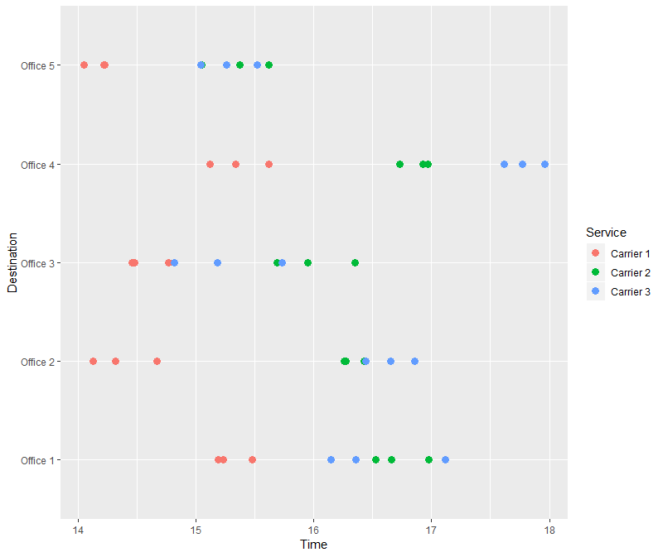
Example #2 – Plotted Data
The data is then displayed using a dot plot for an initial visual investigation of any trends in delivery time between the three services and across the five sub-offices.
The color aesthetic is used to distinguish between the three services in the plot.
> ggplot(delivery.df, aes(Time,
Destination, colour = Service)) +
geom_point(size=3)
The graph shows a general pattern of service carrier 1 having shorter delivery times than the other two services.
There is also an indication that the differences between the services varies for the five sub-offices and we might expect the interaction term to be significant in the two-way ANOVA model.

Slide 22
Example #2 – ANOVA Model
To fit the two-way ANOVA model we use this code:
> delivery.mod1 = aov(Time ~
Destination*Service,
data = delivery.df)
The * symbol instructs R to create a formula that includes main effects for both Destination and Service as well as the two-way interaction between these two factors.
We save the fitted model to an object which we can summarize as follows to test for importance of the various model terms:
> summary(delivery.mod1)
Df Sum Sq Mean Sq F value Pr(>F)
Destination 4 17.542 4.385 61.155 5.41e-14 ***
Service 2 23.171 11.585 161.560 < 2e-16 ***
Destination:Service 8 4.189 0.524 7.302 2.36e-05 ***
Residuals 30 2.151 0.072
---
Signif. codes: 0 ‘***’ 0.001 ‘**’ 0.01 ‘*’ 0.05 ‘.’ 0.1
‘ ’ 1

Slide 23
Example #2 - Discussion
We have strong evidence here of the following differences
between the three delivery services
between the five sub-office destinations
there is an interaction between destination and service in line with what we saw in the original plot of the data
Now that we have fitted the model and identified the important factors we need to investigate the model diagnostics to ensure that the various assumptions are broadly valid
We can plot the model residuals against fitted values to look for obvious trends that are not consistent with the model assumptions about independence and common variance

Slide 24
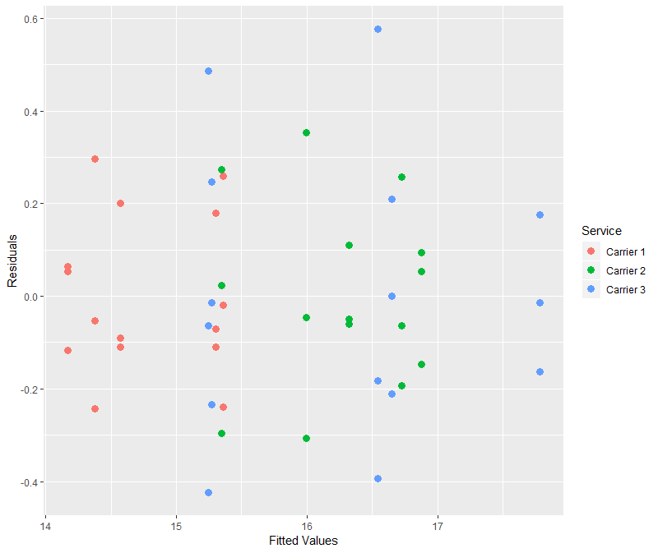
Example #2 – Residuals versus Fitted Values
The first step is to create a data frame with the fitted values and residuals from the above model:
delivery.res = delivery.df
delivery.res$M1.Fit = fitted(delivery.mod1)
delivery.res$M1.Resid = resid(delivery.mod1)
Then a scatter plot is used to display the fitted values and residuals where the colour asthetic highlights which points correspond to the three competing delivery services.
ggplot(delivery.res, aes(M1.Fit,
M1.Resid, colour = Service)) +
geom_point() +
xlab("Fitted Values") +
ylab("Residuals")

Slide 25
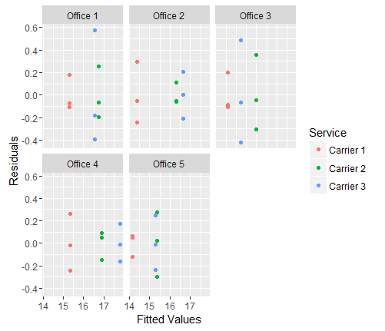
Example #2 – Residuals by Sub-Offices
No obvious problems in this diagnostic plot.
There are no obvious patterns in this plot that suggest problems with the two-way ANOVA model that we fitted to the data.
As an alternative display we could separate the residuals into destination sub-offices, where the facet_wrap() function instructs ggplot to create a separate display (panel) for each of the destinations.
ggplot(delivery.res, aes(M1.Fit, M1.Resid,
colour = Service)) +
geom_point(size = 3) +
xlab("Fitted Values") +
ylab("Residuals") +
facet_wrap( ~ Destination)

Slide 26
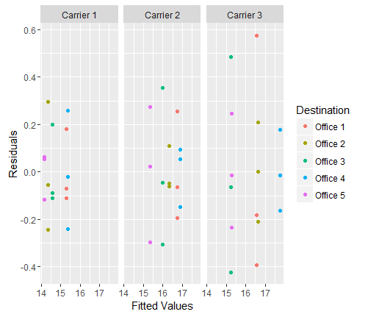
Example #2 – Residuals by Delivery Service
We could also consider dividing the data by delivery service to get a different view of the residuals:
ggplot(delivery.res, aes(M1.Fit, M1.Resid,
colour = Destination)) +
geom_point() +
xlab("Fitted Values") +
ylab("Residuals") +
facet_wrap( ~ Service)
Nothing substantial here to lead us to consider an alternative analysis

Slide 27
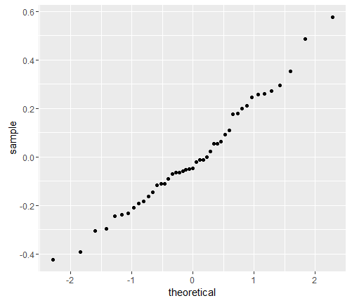
Example #2 – Residual qq Plot
Also, we consider the normal probability plot of the model residuals, using the stat_qq() option:
ggplot(delivery.res, aes(sample = M1.Resid)) + stat_qq()
This plot is very close to the straight line we would expect to observe if the data was a close approximation to a normal distribution.

Slide 28
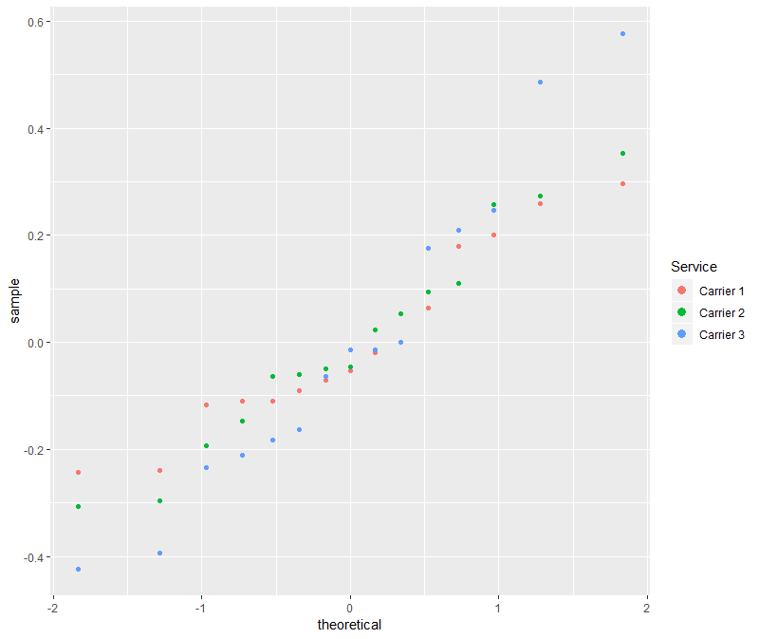
Example #2 – Residuals by Service
We could also consider the normal probability plot of the model residuals by Service
ggplot(delivery.res, aes(sample =
M1.Resid, colour=Service)) + stat_qq() +
geom_point(x=delivery.res$M1.Fit,
y=delivery.res$M1.Resid, size=3)
Even with the multiple comparison post-hoc adjustment there is very strong evidence for the differences that we have consistently observed throughout the analysis

Slide 29
Example #2
To round off the analysis we look at the Tukey HSD multiple comparisons to confirm that the differences are between delivery service 1 and the other two competing services:
TukeyHSD(delivery.mod1, which = "Service")
Tukey multiple comparisons of means
95% family-wise confidence level
Fit: aov(formula = Time ~ Destination * Service, data = delivery.df)
$Service
diff lwr upr p adj
Carrier 2-Carrier 1 1.498667 1.2576092 1.7397241 0.0000000
Carrier 3-Carrier 1 1.544667 1.3036092 1.7857241 0.0000000
Carrier 3-Carrier 2 0.046000 -0.1950575 0.2870575 0.8856246

Slide 30
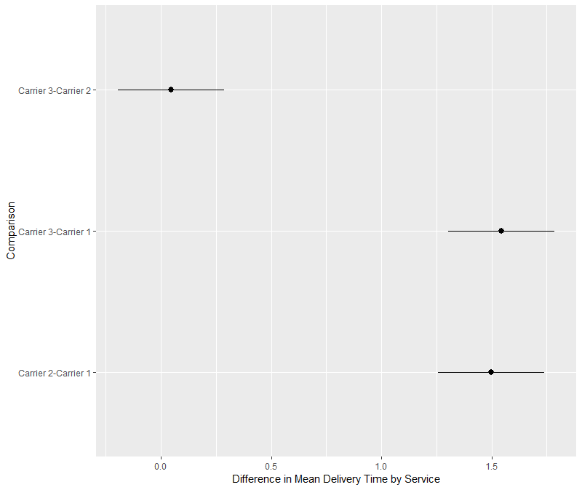
Example #2 – Difference in Mean Delivery Times
We can use ggplot to visualize the difference in mean delivery time for the services and the 95% confidence intervals on these differences.
We create a data frame from the TukeyHSD output by extracting the component relating to the delivery service comparison and add the text labels by extracting the row names from the data frame.
delivery.hsd = data.frame(TukeyHSD(delivery.mod1, which = "Service")$Service)
delivery.hsd$Comparison = row.names(delivery.hsd)
We then use the geom_pointrange() to specify lower, middle and upper values based on the three pairwise comparisons of interest.
> ggplot(delivery.hsd, aes(Comparison, y = diff,
ymin = lwr, ymax = upr)) +
geom_pointrange() +
ylab("Difference in Mean Delivery Time by Service") +
coord_flip()
The coord_flip() is used to make the confidence intervals horizontal rather than vertical on the graph.

Slide 31
www.humalytica.com
http://www.amazon.com/Jeffrey-Strickland/e/B00IQ69QZK/
http://www.lulu.com/spotlight/strickland_jeffrey

